Slide 1

Network Monitoring Tool
Presented to Mrs T. Vasavi
Ajay 237R1A0503
Bellary Vyshnavi 237R1A0510
Bonigala Sudeepthi 237R1A0513
Enugala Pavithra 237R1A0518

Slide 2



Introduction
Tool to monitor network performance.
Measures download/upload speed, latency, and packet loss.
Developed using Python with simple GUI.
Provides real-time display of network metrics.
Demonstrates practical networking concepts.

Slide 3

Objectives
Monitor network performance in real-time.
Measure download and upload speeds accurately.
Check latency and packet loss to assess connection quality.
Display network metrics through a user-friendly GUI.
Demonstrate practical networking concepts clearly.

Slide 4

Features
Real-time bandwidth measurement (Download & Upload).
Ping test for latency measurement.
Packet loss detection for connection reliability.
User-friendly GUI for easy monitoring.
Status messages to indicate network condition.

Slide 5
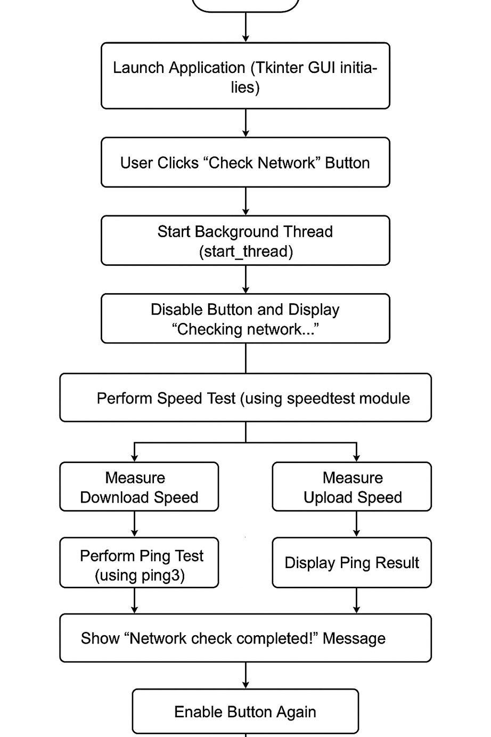
⚙️
Implementation
GUI setup using Python Tkinter.
Measure download and upload speed using speedtest-cli.
Perform ping test using ping3 for latency and packet loss.
Display results on GUI in real-time.
Optional: Save logs for later analysis.

Slide 6
Source code
import tkinter as tk
import speedtest
from ping3 import ping
def check_network():
st = speedtest.Speedtest()
download = st.download() / 1_000_000
upload = st.upload() / 1_000_000
latency = ping("google.com") * 1000
download_label.config(text=f"Download: {download:.2f} Mbps")
upload_label.config(text=f"Upload: {upload:.2f} Mbps")
ping_label.config(text=f"Ping: {latency:.2f} ms")

Slide 7
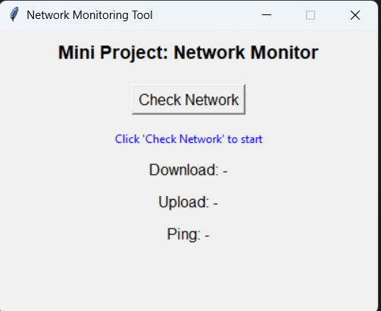
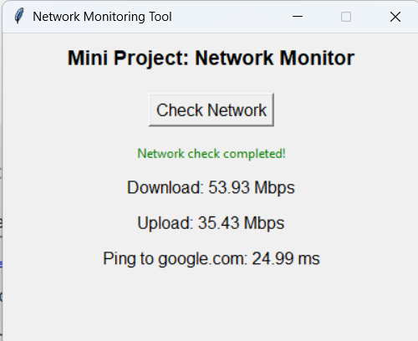
Output

Slide 8

Advantages
Real-time network monitoring for better insight.
User-friendly GUI makes metrics easy to read.
Measures key parameters like speed, latency, and packet loss.
Lightweight and easy to run on any system.
Demonstrates practical networking concepts clearly.

Slide 9

Future Enhancements
Add graphical charts for bandwidth and latency trends over time.
Include multi-server ping tests for global network analysis.
Implement alert system for network downtime or slow speed.
Add historical log saving and visualization.
Make it cross-platform for Windows, Linux, and Mac.

Slide 10

Thank you

